Slide 1
Customers Segmentation by RFM
a brief introduction to

Slide 2
10 equal groups vs RFM segments
200 | 200 | 200 | 200 | 200 | 200 | 200 | 200 | 200 | 200
200 | 200 | 200 | 200 | 200 | 200 | 200 | 200 | 200 | 200
200 | 200 | 200 | 200 | 200 | 200 | 200 | 200 | 200 | 200
400 | 400 | 200 | 200 | 200 | 200 | 200 | 200 | 200 | 200
400 | 400 | 400 | 400 | 400 | 400 | 400 | 400 | 400 | 400
400 | 400 | 400 | 400 | 400 | 400 | 400 | 400 | 400 | 400
400 | 400 | 400 | 400 | 400 | 400 | 400 | 400 | 400 | 400
600 | 600 | 600 | 600 | 600 | 600 | 400 | 400 | 400 | 400
600 | 600 | 600 | 600 | 600 | 600 | 600 | 600 | 600 | 600
600 | 600 | 600 | 600 | 600 | 600 | 600 | 600 | 600 | 600
38%
36%
26%

Slide 3
10 equal groups vs RFM segments
200 | 200 | 200 | 200 | 200 | 200 | 200 | 200 | 200 | 200 | 1
200 | 200 | 200 | 200 | 200 | 200 | 200 | 200 | 200 | 200 | 2
200 | 200 | 200 | 200 | 200 | 200 | 200 | 200 | 200 | 200 | 3
400 | 400 | 200 | 200 | 200 | 200 | 200 | 200 | 200 | 200 | 4
400 | 400 | 400 | 400 | 400 | 400 | 400 | 400 | 400 | 400 | 5
400 | 400 | 400 | 400 | 400 | 400 | 400 | 400 | 400 | 400 | 6
400 | 400 | 400 | 400 | 400 | 400 | 400 | 400 | 400 | 400 | 7
600 | 600 | 600 | 600 | 600 | 600 | 400 | 400 | 400 | 400 | 8
600 | 600 | 600 | 600 | 600 | 600 | 600 | 600 | 600 | 600 | 9
600 | 600 | 600 | 600 | 600 | 600 | 600 | 600 | 600 | 600 | 10
38%
36%
26%

Slide 4
10 equal groups vs RFM segments
200 | 200 | 200 | 200 | 200 | 200 | 200 | 200 | 200 | 200 | 3 (<=200)
200 | 200 | 200 | 200 | 200 | 200 | 200 | 200 | 200 | 200
200 | 200 | 200 | 200 | 200 | 200 | 200 | 200 | 200 | 200
400 | 400 | 200 | 200 | 200 | 200 | 200 | 200 | 200 | 200
400 | 400 | 400 | 400 | 400 | 400 | 400 | 400 | 400 | 400 | 2 (>200 <600)
400 | 400 | 400 | 400 | 400 | 400 | 400 | 400 | 400 | 400
400 | 400 | 400 | 400 | 400 | 400 | 400 | 400 | 400 | 400
600 | 600 | 600 | 600 | 600 | 600 | 400 | 400 | 400 | 400
600 | 600 | 600 | 600 | 600 | 600 | 600 | 600 | 600 | 600 | 1 (>=600)
600 | 600 | 600 | 600 | 600 | 600 | 600 | 600 | 600 | 600
38%
36%
26%

Slide 5
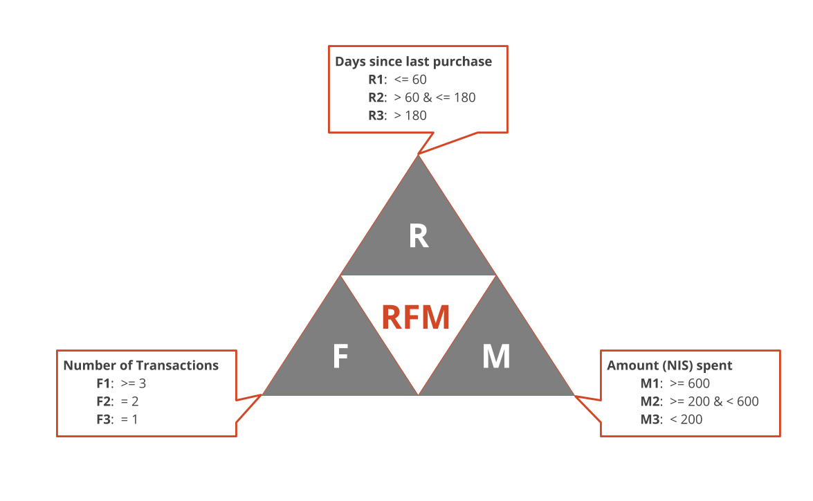
RFM Parameters
R
Recency
Frequency
Monetary value
F
M

Slide 6
Customer segments
1
(Recent)
R: <= 180 days
2
Churn-signal
R: > 180 days

Slide 7
Customer segments
1
(Recent)
R: <= 180 days
2
Churn-signal
R: > 180 days
1
Platinum
F: >= 3 transactions
M: >= 600 NIS
2
Gold
F: >= 3 transactions
M: < 600 NIS
3
Silver
F: = 2 transactions
M: = any
4
One-timers
F: = 1 transaction
M: = any

Slide 8
Customer segments
1
(Recent)
R: <= 180 days
2
Churn-signal
R: > 180 days
1
Platinum
F: >= 3 transactions
M: >= 600 NIS
2
Gold
F: >= 3 transactions
M: < 600 NIS
3
Silver
F: = 2 transactions
M: = any
4
One-timers
F: = 1 transaction
M: = any

Slide 9
RFM segments – 12 months ending on March 31, 2019
Q2,2018 – Q1,2019
average profit (NIS) | average basket (NIS) | average recency (days) | average frequency | transactions % | transactions | gross amount % | gross amount (NIS) | customers % | customers | segment
45 | 224 | 45 | 13.1 | 47% | 80,968 | 45% | 2,860,016 | 15% | 5,610 | Platinum
24 | 122 | 67 | 7.1 | 9% | 15,997 | 4% | 261,815 | 7% | 2,558 | Gold
46 | 228 | 74 | 4.0 | 11% | 18,390 | 11% | 723,563 | 12% | 4,544 | Silver
53 | 263 | 81 | 1.0 | 17% | 28,440 | 21% | 1,309,922 | 33% | 12,508 | One-timers
64 | 320 | 224 | 8.4 | 1% | 1,670 | 2% | 139,238 | 2% | 887 | Churn-signal Platinum
24 | 119 | 225 | 6.6 | 1% | 1,306 | 0% | 22,413 | 2% | 919 | Churn-signal Gold
44 | 222 | 243 | 4.0 | 3% | 5,426 | 4% | 228,313 | 5% | 1,951 | Churn-signal Silver
49 | 245 | 262 | 1.0 | 11% | 18,388 | 12% | 790,198 | 23% | 8,487 | Churn-signal One-timers
44 | 262 | 153 | 2.2 | 100% | 170,584 | 100% | 6,335,477 | 100% | 37,464 | Total
* The numbers shown in table are not real and are not based on any real company data, they are for presentation purposes only

Slide 10
RFM segments – 12 months ending on March 31, 2019
Q2,2018 – Q1,2019
average profit (NIS) | average basket (NIS) | average recency (days) | average frequency | transactions % | transactions | gross amount % | gross amount (NIS) | customers % | customers | segment
45 | 224 | 45 | 13.1 | 47% | 80,968 | 45% | 2,860,016 | 15% | 5,610 | Platinum
24 | 122 | 67 | 7.1 | 9% | 15,997 | 4% | 261,815 | 7% | 2,558 | Gold
46 | 228 | 74 | 4.0 | 11% | 18,390 | 11% | 723,563 | 12% | 4,544 | Silver
53 | 263 | 81 | 1.0 | 17% | 28,440 | 21% | 1,309,922 | 33% | 12,508 | One-timers
64 | 320 | 224 | 8.4 | 1% | 1,670 | 2% | 139,238 | 2% | 887 | Churn-signal Platinum
24 | 119 | 225 | 6.6 | 1% | 1,306 | 0% | 22,413 | 2% | 919 | Churn-signal Gold
44 | 222 | 243 | 4.0 | 3% | 5,426 | 4% | 228,313 | 5% | 1,951 | Churn-signal Silver
49 | 245 | 262 | 1.0 | 11% | 18,388 | 12% | 790,198 | 23% | 8,487 | Churn-signal One-timers
44 | 262 | 153 | 2.2 | 100% | 170,584 | 100% | 6,335,477 | 100% | 37,464 | Total

Slide 11
RFM segments – 12 months ending on March 31, 2019
Q2,2018 – Q1,2019
average profit (NIS) | average basket (NIS) | average recency (days) | average frequency | transactions % | transactions | gross amount % | gross amount (NIS) | customers % | customers | segment
45 | 224 | 45 | 13.1 | 47% | 80,968 | 45% | 2,860,016 | 15% | 5,610 | Platinum
24 | 122 | 67 | 7.1 | 9% | 15,997 | 4% | 261,815 | 7% | 2,558 | Gold
46 | 228 | 74 | 4.0 | 11% | 18,390 | 11% | 723,563 | 12% | 4,544 | Silver
53 | 263 | 81 | 1.0 | 17% | 28,440 | 21% | 1,309,922 | 33% | 12,508 | One-timers
64 | 320 | 224 | 8.4 | 1% | 1,670 | 2% | 139,238 | 2% | 887 | Churn-signal Platinum
24 | 119 | 225 | 6.6 | 1% | 1,306 | 0% | 22,413 | 2% | 919 | Churn-signal Gold
44 | 222 | 243 | 4.0 | 3% | 5,426 | 4% | 228,313 | 5% | 1,951 | Churn-signal Silver
49 | 245 | 262 | 1.0 | 11% | 18,388 | 12% | 790,198 | 23% | 8,487 | Churn-signal One-timers
45 | 224 | 45 | 13.1 | 47% | 80,968 | 45% | 2,860,016 | 15% | 5,610 | Total

Slide 12
RFM segments – same period last year comparison
Q2,2018 – Q1,2019
average profit (NIS) | average basket (NIS) | average recency (days) | average frequency | transactions % | transactions | gross amount % | gross amount (NIS) | customers % | customers | segment
45 | 224 | 45 | 13.1 | 47% | 80,968 | 45% | 2,860,016 | 15% | 5,610 | Platinum
24 | 122 | 67 | 7.1 | 9% | 15,997 | 4% | 261,815 | 7% | 2,558 | Gold
46 | 228 | 74 | 4.0 | 11% | 18,390 | 11% | 723,563 | 12% | 4,544 | Silver
53 | 263 | 81 | 1.0 | 17% | 28,440 | 21% | 1,309,922 | 33% | 12,508 | One-timers
Same period last year: Q2,2017 – Q1,2018
average profit (NIS) | average basket (NIS) | average recency (days) | average frequency | transactions % | transactions | gross amount % | gross amount (NIS) | customers % | customers | segment
 |  |  |  |  |  |  |  |  |  | Platinum
 |  |  |  |  |  |  |  |  |  | Gold
 |  |  |  |  |  |  |  |  |  | Silver
 |  |  |  |  |  |  |  |  |  | One-timers

Slide 13
RFM segments – quarter to quarter comparison
Q2,2018 – Q1,2019
average profit (NIS) | average basket (NIS) | average recency (days) | average frequency | transactions % | transactions | gross amount % | gross amount (NIS) | customers % | customers | segment
45 | 224 | 45 | 13.1 | 47% | 80,968 | 45% | 2,860,016 | 15% | 5,610 | Platinum
24 | 122 | 67 | 7.1 | 9% | 15,997 | 4% | 261,815 | 7% | 2,558 | Gold
46 | 228 | 74 | 4.0 | 11% | 18,390 | 11% | 723,563 | 12% | 4,544 | Silver
53 | 263 | 81 | 1.0 | 17% | 28,440 | 21% | 1,309,922 | 33% | 12,508 | One-timers
12 months ending in previous quarter: Q1,2018 – Q4,2018
average profit (NIS) | average basket (NIS) | average recency (days) | average frequency | transactions % | transactions | gross amount % | gross amount (NIS) | customers % | customers | segment
 |  |  |  |  |  |  |  |  |  | Platinum
 |  |  |  |  |  |  |  |  |  | Gold
 |  |  |  |  |  |  |  |  |  | Silver
 |  |  |  |  |  |  |  |  |  | One-timers

Slide 14

Value of customer segmentation
Active customers retention
Churn-signal customers re-engagement
Targeted marketing
Notes:
In Slide Show mode, select the arrows to visit links.

